Slide 1

FOURIER TRANSFORMS
DAVID COOPER
SUMMER 2014

Slide 2
Signal Processing
The true value in loading data into MATLAB is the ability to manipulate it and further process your signal
Common signal processing functions are convolution and correlation of two signals, auto-correlation of a signal with itself, transforming the signal into frequency domain, and separating a signal into base components.
For most applications we are dealing with signals that are measured across time and therefore exist only in the real positive axis. These functions can all be generalize to extend beyond those restrictions

Slide 3
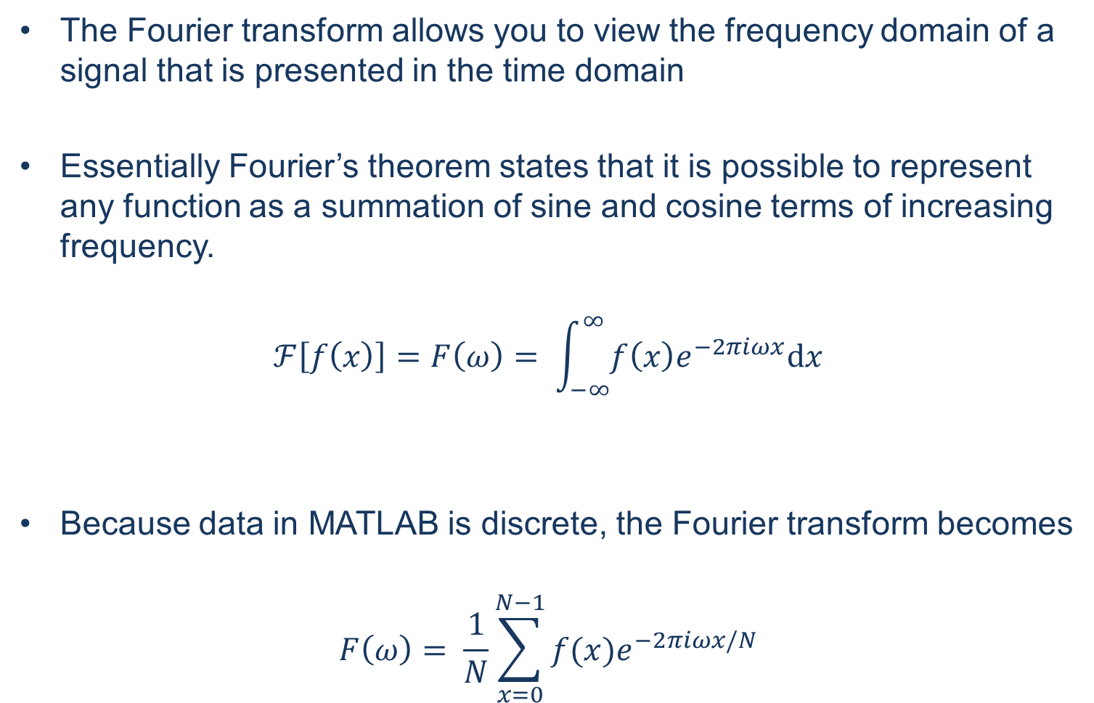
Fourier Transform

Slide 4
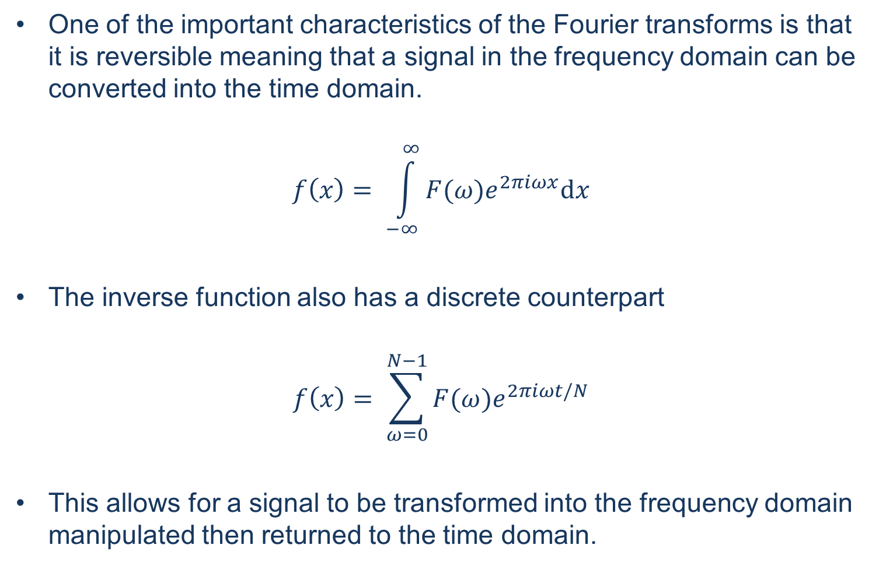
Inverting the Fourier Transform

Slide 5
Fast Fourier Transform
MATLAB has built in functions for parsing the Fourier transform from a given set of data
>> X = fft(x)
>> x = ifft(X)
The resulting variable will be a series of complex numbers that is equal to in length to the input variable
This complex number can also be represented by its magnitude and phase
>> Xmag = abs(X)
>> Xphase = angle(X)
To recombine the magnitude and phase after seperating
>>Xreconstruct = Xmag*cos(Xphase)+i*Xmag*sin(Xphase)

Slide 6
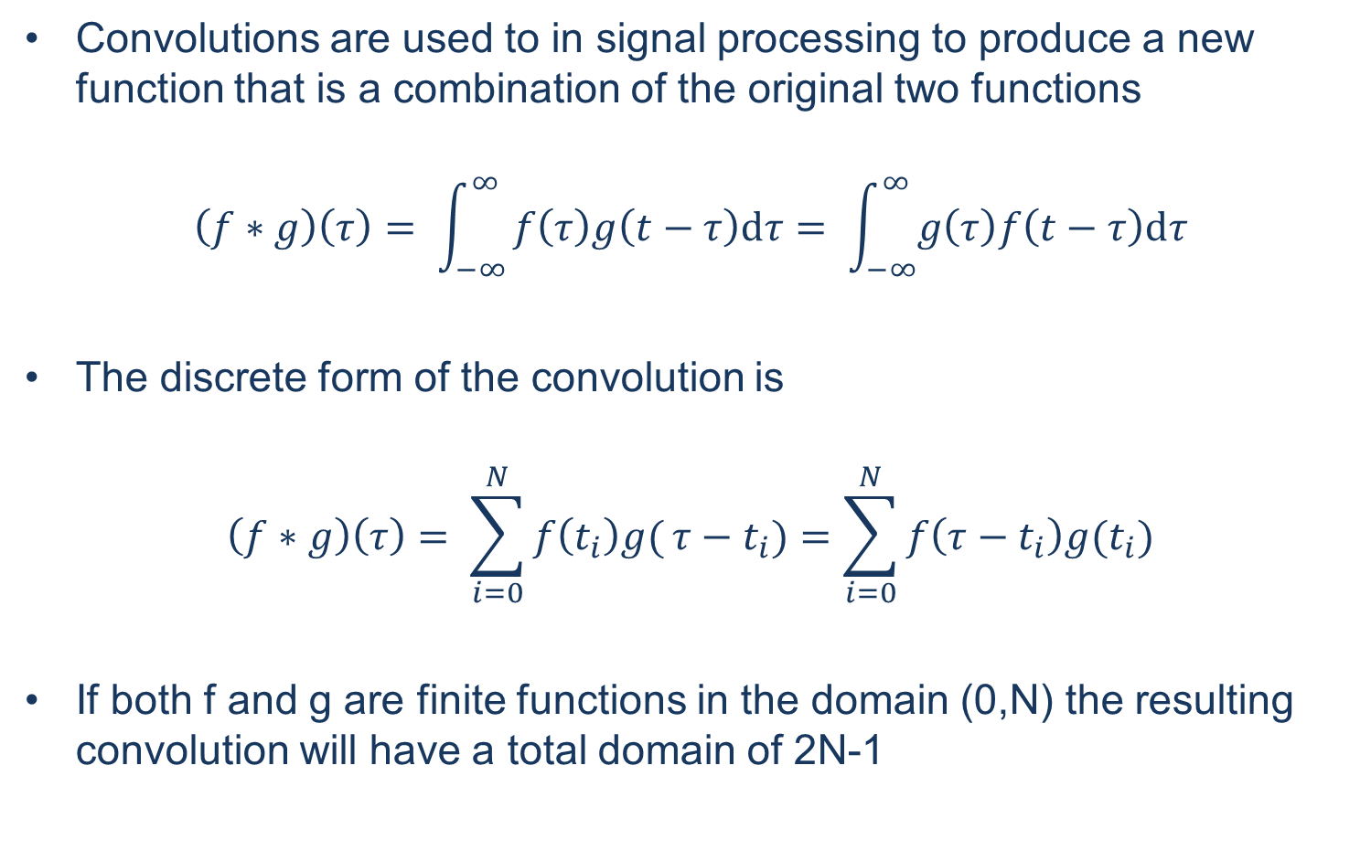
Convolution

Slide 7
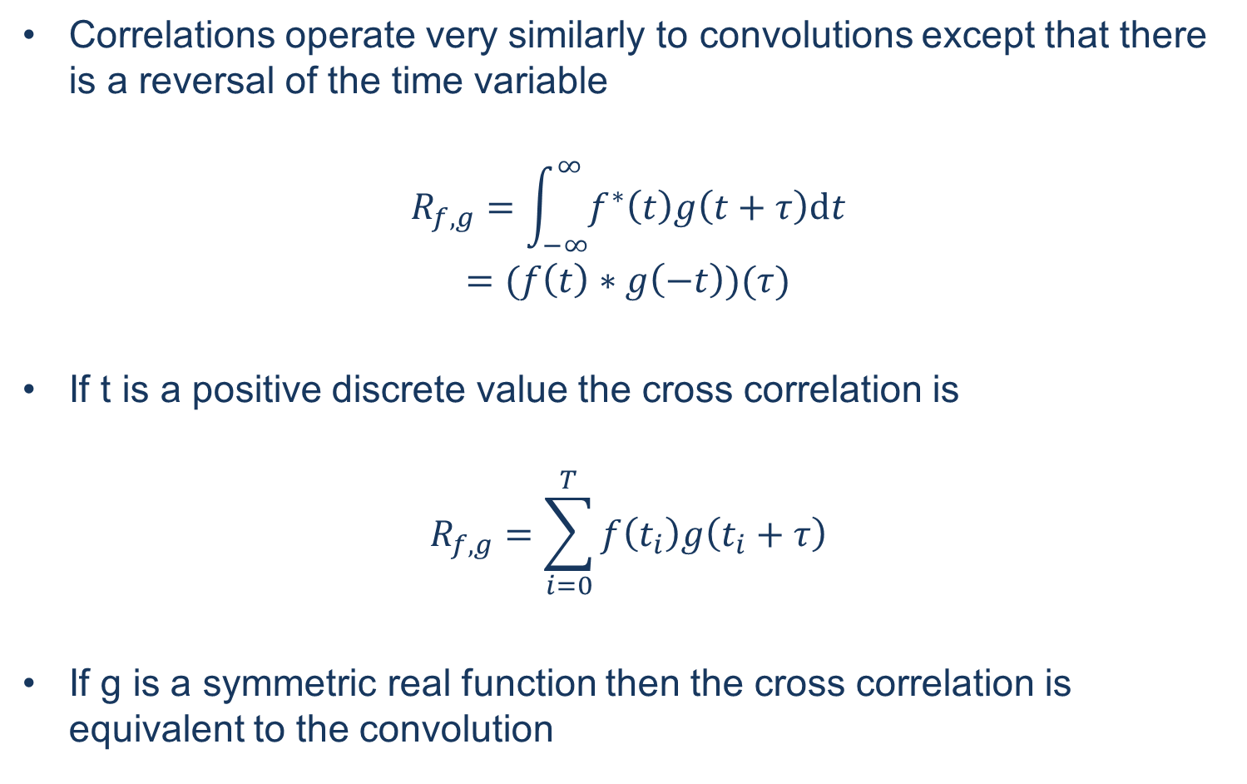
Cross-Correlation

Slide 8
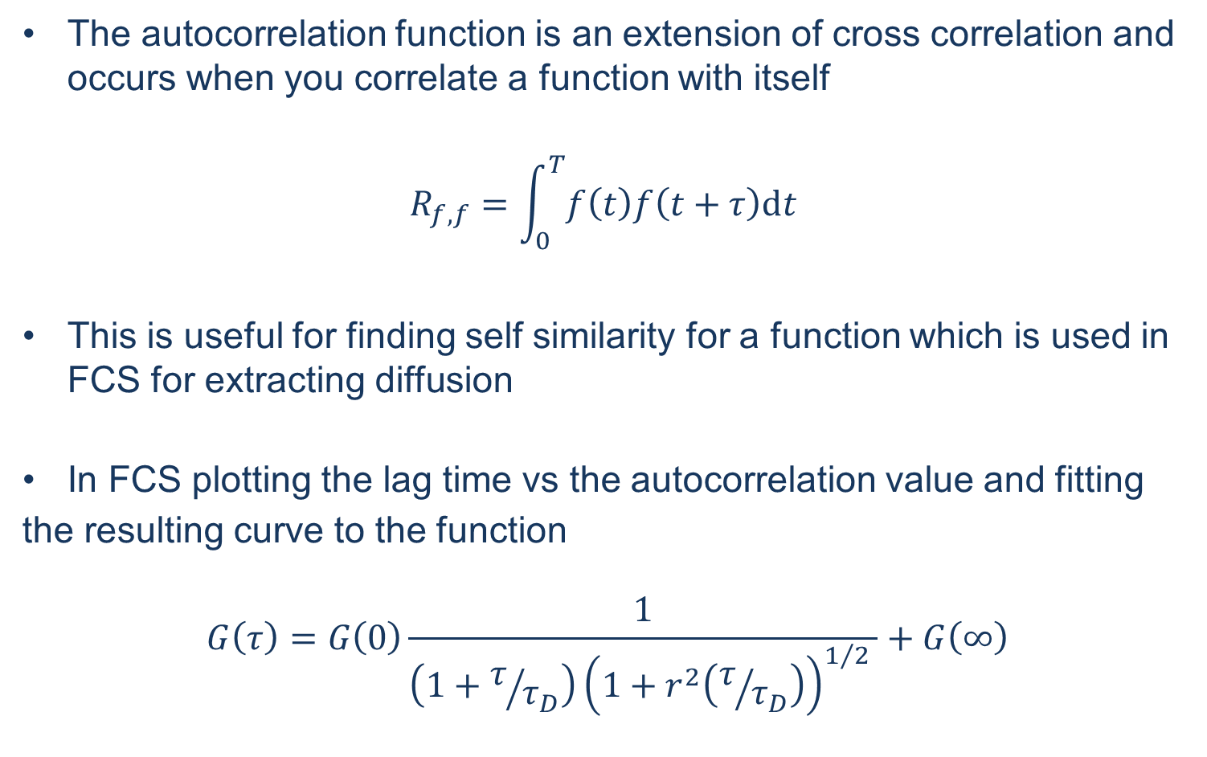
Autocorrelation

Slide 9
Calculating Convolutions in MATLAB
To calculate the convolution in MATLAB use the conv() function
>> h = conv(f,g)
You can similarly deconvolve a function if you know one of the input functions
>> [g, r] = deconv(h,f)
The correlation functions are called with the xcorr() function
>> c = xcorr(f,g)
By giving only a single input to the xcorr() function MATLAB will calculate its autocorrelation function
>> ac = xcorr(f)

Slide 10
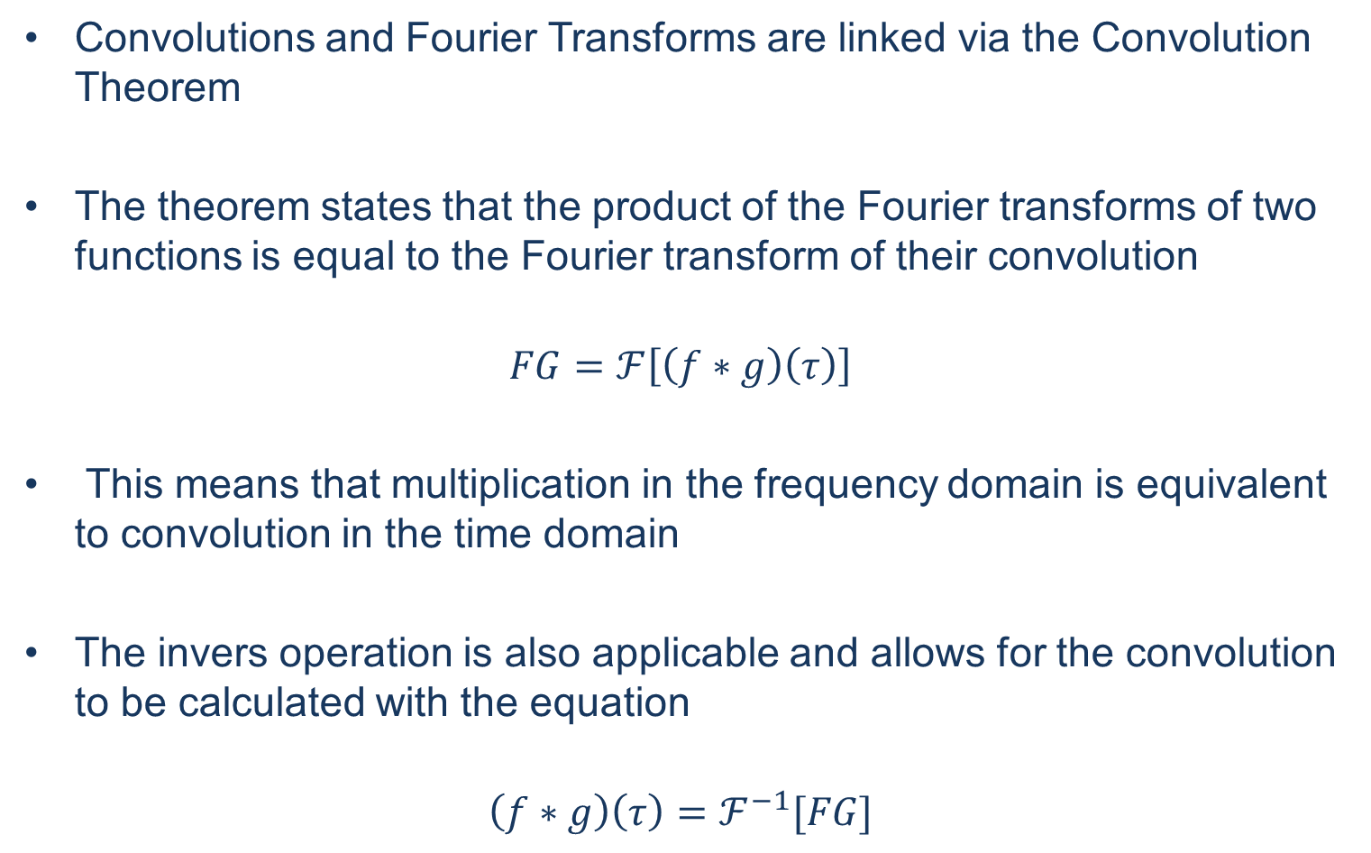
Convolution Theorem

